Slide 1

Highs and Lows
A review of the care provided to patients over the age of 16 who had diabetes and underwent a surgical procedure
Principal recommendations
Notes:
Presenter’s notes:
This presentation can be used to present the principal recommendations from the report Highs and Lows. This looked at care received by patients over the age of 16 who had diabetes and underwent a surgical procedure.
It will only cover the principal recommendations and the full set of recommendations can be found in the report.
More information can be found at www.ncepod.org.uk.

Slide 2
The study
Review of the care provided to patients over the age of 16 who had diabetes and underwent a surgical procedure
Organisational questionnaire
Surgical questionnaire
Anaesthetic questionnaire
Case note review
Notes:
Presenter’s notes:
The study looked at care provided to patients over the age of 16 who had diabetes and underwent a surgical procedure. Organisational data, questionnaires completed by surgeons and anaesthetists and case notes were used to build a picture of how this patient group is being cared for.
Case notes were reviewed by clinicians with experience of working with people with diabetes.

Slide 3
Study population
Patients aged 16 and over
Admitted to hospital either as an emergency or for an elective procedure with an ICD10 code for diabetes mellitus (E10.0-E11.9)
A major surgical procedure with a minimum one night stay post-surgery between 1st February 2017 and 31st March 2017.
Notes:
Presenter’s notes:
The study population was:​
patients aged 16 and over ​
admitted to hospital who had an ICD10 code for diabetes mellitus​
had a major surgical procedure with at least a one-night stay after surgery during the study period.​

Slide 4
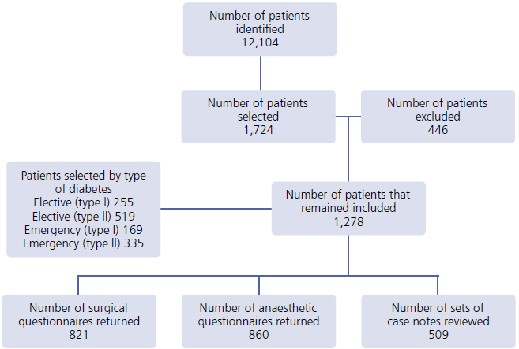
Study sample
Notes:
Presenter’s notes:
Out of around 12,000 patients, 1724 were selected for case note review. 446 of these were excluded for various reasons. 509 sets of cases notes were received and reviewed.

Slide 5
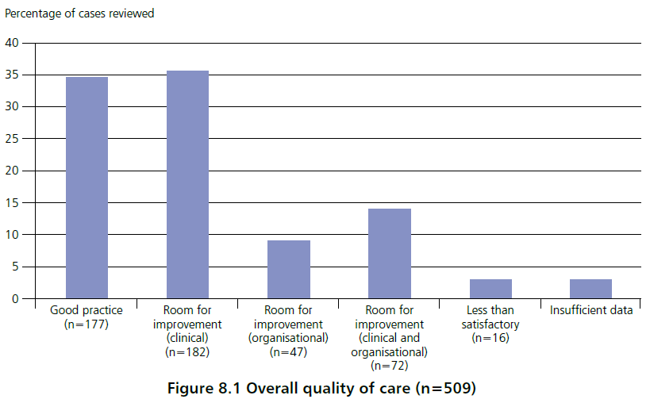
Overall assessment of care
Notes:
Presenter’s notes:
Case note reviewers assessed the overall quality of care for each case. Almost 35% were felt to demonstrate good practice. Slightly more than this had room for improvement in clinical care. Almost 15% showed room for improvement in clinical and organisational factors. A very small number were considered to be less than satisfactory.

Slide 6
Key messages (1)
Lack of clinical continuity of diabetes management across the different specialties in the perioperative pathway
Absence of joint ownership of the diabetes management
Multiple guidelines targeted at specific specialties, rather than a joint multidisciplinary approach, creating gaps in the surgical pathway
Notes:
Presenter’s notes:
Key messages from the report are:
Lack of clinical continuity across the specialties in the perioperative pathway
Lack of joint ownership of the management of diabetes
Although there are several guidelines for the management of diabetes in the perioperative period, they are unidisciplinary rather than multidisciplinary and so don’t necessarily provide a seamless approach to patient care.

Slide 7
Key messages (2)
Under-involvement of key diabetes team members
Nutritional assessments and medicine reconciliations were frequently not undertaken
Patients were not prioritised appropriately, which subjected them to prolonged fasting
Regular monitoring of blood glucose was under-utilised pre-, intra- and post-operatively
Notes:
Presenter’s notes:
Key messages from the report are (2):
Diabetes team members should have been involved more
Nutritional assessments and medicine reconciliations were often not carried out
Patients with diabetes were not prioritised appropriately which could lead to them fasting for a prolonged period
Monitoring of blood glucose throughout the operative period could be improved

Slide 8
Recommendation 1
Write and implement a national joint standard and policy for the multidisciplinary management of patients with diabetes who require surgery. Information should include responsibilities for diabetes management across all specialties during routine care and in high-risk patients.
Notes:
Presenter’s notes:
This recommendation is aimed at the Academy of Medical Royal Colleges to lead at an organisational level, and the Clinical Lead for Perioperative Diabetes Management to lead at a local level.
A policy for the multidisciplinary management of patients with diabetes who undergo surgery is required. It should cover all relevant specialties and both routine and high-risk patients.

Slide 9
Recommendation 2
Appoint a clinical lead for perioperative diabetes care in hospitals where surgical services are provided. This person will be responsible for developing policies and processes to:
Ensure diabetes management is optimised for surgery
Ensure patients with diabetes are prioritised on the operating list, including the co-ordination of emergency surgery
Identify when involvement of the diabetes multidisciplinary team, including diabetes specialist nurse, is required
Notes:
Presenter’s notes:
This recommendation is aimed at Medical Directors and Directors of Nursing.
Hospitals where surgical services are provided should have a clinical lead for perioperative diabetes care. The lead will be responsible for developing policies and processes to:
Ensure diabetes management is optimised for surgery
Ensure patients with diabetes are prioritised on the operating list – that is, early in the morning or afternoon to avoid prolonged fasting
Identify when involvement of the diabetes multidisciplinary team is required

Slide 10
Recommendation 2
Appoint a clinical lead for perioperative diabetes care in hospitals where surgical services are provided. This person will be responsible for developing policies and processes to:
Ensure high-risk patients are identified, such as those with type 1 diabetes
Identify patients with poor diabetes control who may need pre-operative optimisation or variable rate intravenous insulin infusion (VRIII)
Audit cases of prolonged starvation
Ensure high-quality discharge planning.
Notes:
Presenter’s notes:
This recommendation is aimed at Medical Directors and Directors of Nursing.
Hospitals where surgical services are provided should have a clinical lead for perioperative diabetes care. The lead will be responsible for developing policies and processes to:
Ensure high-risk patients are identified
Identify patients with poor diabetes control who may need pre-operative optimisation or VRIII (variable rate intravenous insulin infusion)
Audit cases of prolonged starvation
Ensure high-quality discharge planning.

Slide 11
Recommendation 3
Use a standardised referral process for elective surgery to ensure appropriate assessment and optimisation of diabetes.
This should include:
Satisfactory HbA1c levels within 3 months of referral
Control of co-morbidities
A list of all current medications
The patient’s body mass index (BMI)
Estimated glomerular filtration rate (eGFR)
Perioperative risk rating.
Notes:
Presenter’s notes:
This recommendation is aimed at Primary Care Providers, Commissioners, Clinical Lead for Perioperative Diabetes Management and Lead anaesthetist for pre-operative assessment.
A standardised referral process for elective surgery should be in place. It should include:
Satisfactory HbA1c levels within 3 months of referral
Control of co-morbidities
A list of all current medications
The patient’s body mass index (BMI)
Estimated glomerular filtration rate (eGFR)
Perioperative risk rating.

Slide 12
Recommendation 4
Ensure that patients with diabetes undergoing surgery are closely monitored and their glucose levels managed accordingly. Glucose monitoring should be included:
at sign-in and sign-out stages of the surgical safety checklist (e.g. WHO safety checklist)
in anaesthetic charts
in theatre recovery
in early warning scoring systems
Notes:
Presenter’s notes:
This recommendation is aimed at Clinical Lead for Perioperative Diabetes Management, Lead Anaesthetist for PreOperative Assessment, Clinical Directors, Medical Directors, Directors of Nursing.
Patients with diabetes undergoing surgery should be closely monitored and their glucose levels managed accordingly. Glucose monitoring should be included:
at sign-in and sign-out stages of the surgical safety checklist (e.g. WHO safety checklist)
in anaesthetic charts
in theatre recovery
in early warning scoring systems

Slide 13
Recommendation 4
System markers and alerts should be used to raise awareness of glucose levels, e.g. tagging of electronic medical records, use of a patient passport or unique stickers in paper-based case notes.
Notes:
Presenter’s notes:
This recommendation is aimed at Clinical Leads for Perioperative Diabetes Management, Lead Anaesthetists for Pre-operative Assessment, Clinical Directors, Medical Directors, Directors of Nursing.
System markers and alerts should be used to raise awareness of glucose levels. This could be tagging of electronic medical records, use of a patient passport or unique stickers in paper-based case notes.

Slide 14
Recommendation 5
Ensure a safe handover of patients with diabetes from theatre recovery to ward, this should be documented in the case notes and include:
Medications given in theatre
Glucose level on leaving the recovery area
Glucose level on arriving into the ward
Ongoing management of diabetes, especially VRIII
Criteria for contacting the diabetes team.
Notes:
Presenter’s notes:
This recommendation is aimed at Clinical Leads for Perioperative Diabetes Management, Clinical Directors, Medical Directors, Directors of Nursing.
There should be a safe handover of patients with diabetes from theatre recovery to ward. This should be documented in the case notes and include:
Medications given in theatre
Glucose level on leaving the recovery area
Glucose level on arriving into the ward
Ongoing management of diabetes, especially VRIII (variable rate intravenous insulin infusion)
Criteria for contacting the diabetes team.

Slide 15
Discussion
Do we have a clinical lead for perioperative diabetes care?
Do we have policies and processes for perioperative care?
Is there a standard referral process?
Are system markers and alerts used?
How well is handover carried out?

Slide 16
Highs and Lows
Full report, summary and implementation tools are be found at
www.ncepod.org.uk/2018pd.html

